Slide 1
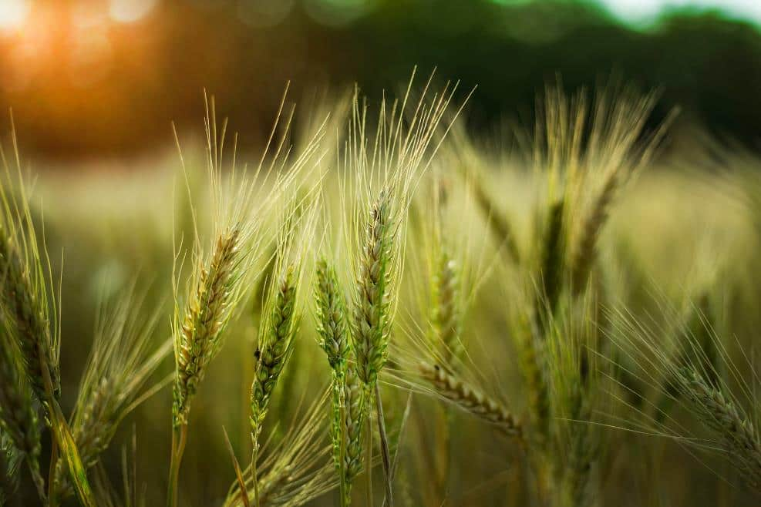
Smart Agriculture and Crop Yield Prediction
Presented by
Kanya Kumari Bikram

Slide 2
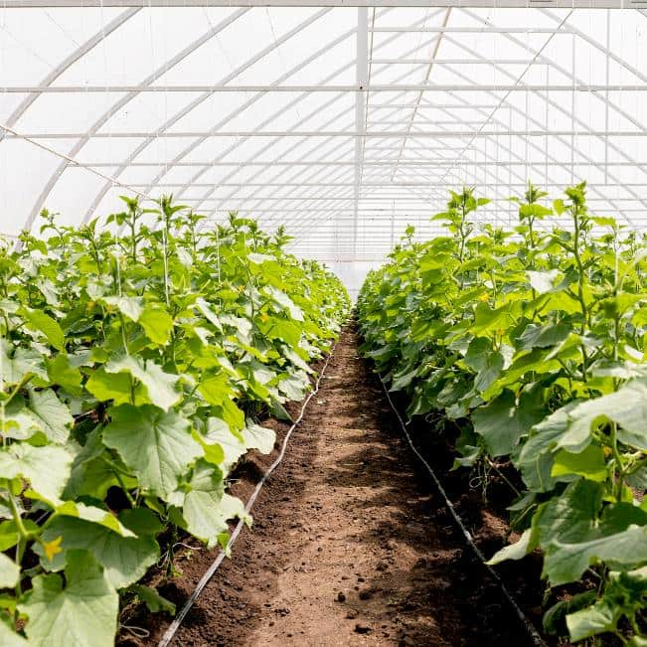
Project Abstract
Agriculture plays a vital role in the economy of many countries, and optimizing crop yield is essential for food security and economic stability. This project uses supervised machine learning techniques to predict the yield of various crops based on historical agricultural data such as rainfall, temperature, soil type, and fertilizer usage. The model leverages regression algorithms like Linear Regression and Random Forest Regressor to make accurate predictions. The goal is to assist farmers and policymakers in making informed decisions regarding crop planning and resource allocation.

Slide 3
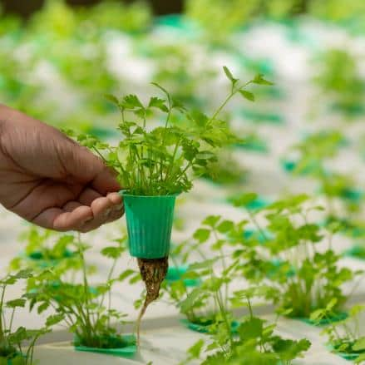
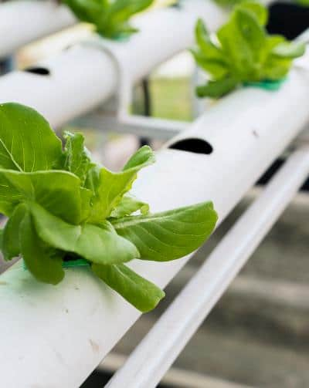
Problem Statement
Farmers often don’t know exactly how much crop they will get because weather and other conditions can change. The old ways of guessing crop yield are usually done by hand or use very little information, so they can be wrong. We need a better way—using data and technology—that looks at many different farming factors to give accurate predictions of how much crop a farmer can expect.
Let me know if you'd like it in a different format or language!

Slide 4


Importance of Crop Yield Prediction
Accurate crop yield prediction enables farmers to make informed decisions on resource allocation, crop management, and market strategies. This data-driven approach increases food security and profitability

Slide 5
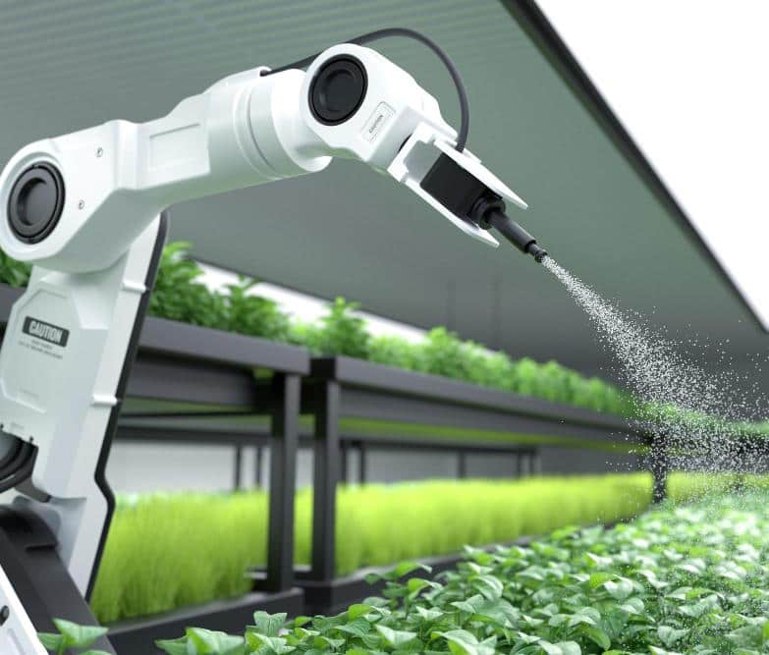
Potential Benefits
Improved Decision-Making: Helps farmers choose the right crop based on environmental factors and expected yield.
Resource Optimization: Enables efficient use of water, fertilizers, weather, Soil type, Season, Pesticide.
Policy Planning: Supports government agencies in policy-making for food supply chain and agriculture subsidies.
Economic Gains: Reduces loss due to poor yield prediction, ensuring better financial planning for farmers.
Scalability: Can be extended to various regions and crop types with updated datasets.

Slide 6

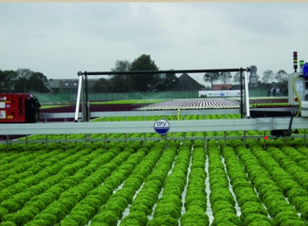
Data Collection
Effective crop yield prediction relies heavily on diverse data collection from agriculture dataset, with filds: weather data, Soil_Type, Season , Water_Usage(cubic meters) , Fertilizer_ Used(tons),Pesticide_Used(kg), Yield(tons), Irrigation_Type.

Slide 7
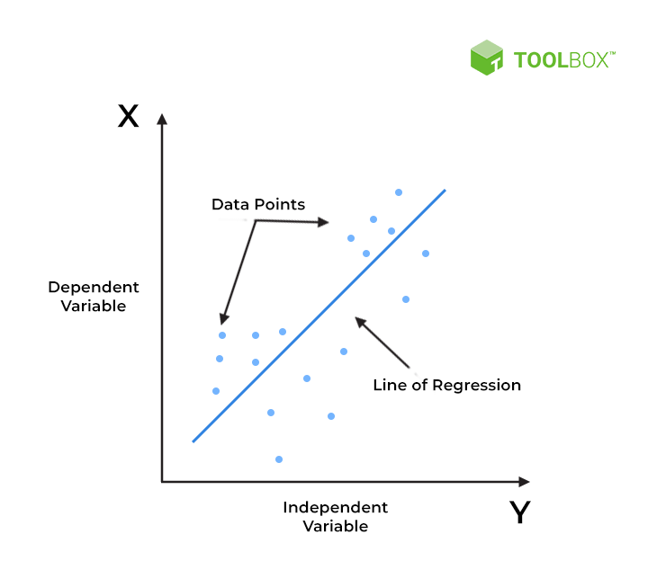
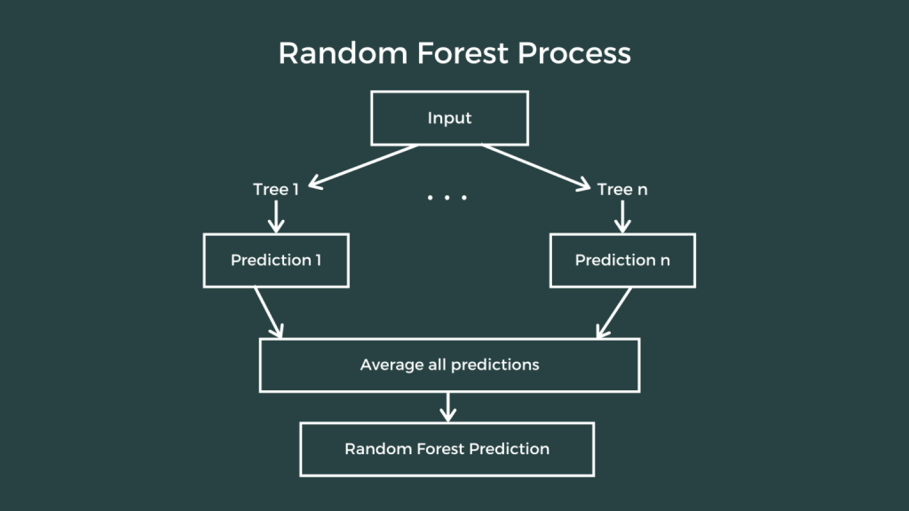

Types of Predictive Models
Linear Regression: A baseline model for predicting the target variable based on linear relationships with the features.
Random Forest Regressor: A more complex model that builds multiple decision trees to improve prediction accuracy.
XGBRegressor: An advanced model that uses gradient boosting to improve prediction performance.

Slide 8
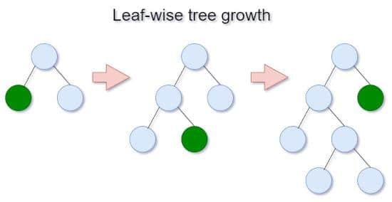
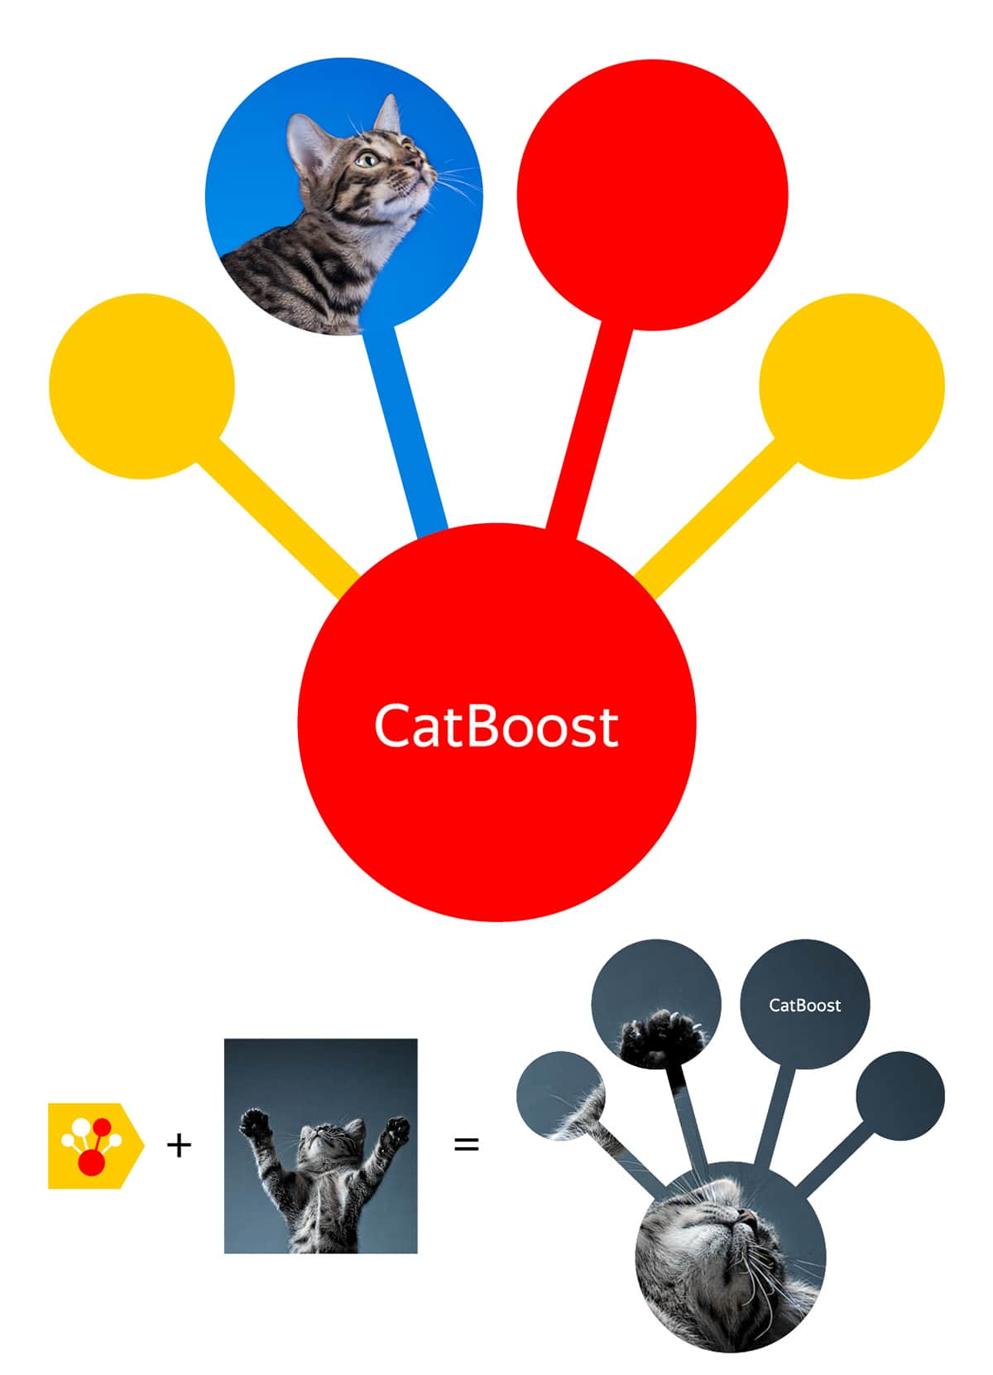
Types of Predictive Models
LightGBM: Is known for its speed and efficiency, especially when dealing with large datasets, which can be beneficial for processing vast amounts of agricultural data.
CatBoost: Gradient boosting algorithms that can be used in agriculture for various tasks like crop yield prediction, irrigation scheduling, and fertilizer recommendation. CatBoost excels at handling categorical features, making it suitable for agricultural datasets that often contain categorical variables like soil type or crop variety.

Slide 9
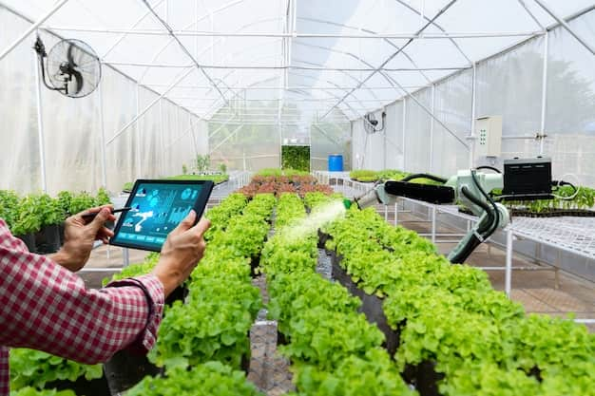
Case Studies of Successful Implementations
Several case studies demonstrate the efficacy of predictive models in agricultural practice. For Instance, precision farming using machine learning has led to a 20% increase in yield for certain crops. These implementations highlight the potential of data-driven approaches to transform traditional farming practices for better productivity.

Slide 10
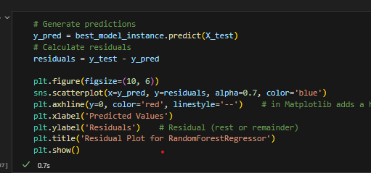
Model Accuracy And Validation
This project focused on analyzing agricultural data at the farm level to understand the key factors influencing crop productivity and to develop predictive models for estimating crop yield. It achieved the highest performance based on evaluation metrics such as Mean Squared Error (MSE) and R-squared (R²).
This project demonstrates how machine learning can support smart agriculture by improving yield estimation and resource planning.

Slide 11
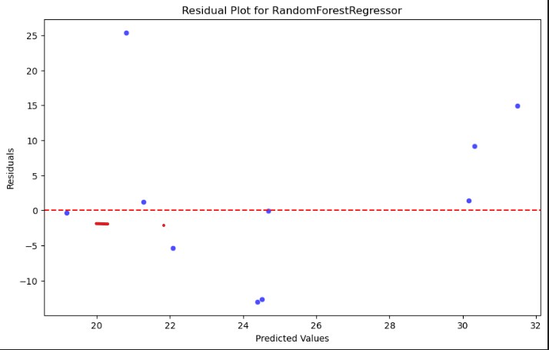
Model Accuracy And Validation
Creates a scatter plot, where the predicted values are on the x-axis and the residuals are on the y-axis.
- Horizontal Line: A red dashed line at y=0 helps in visually assessing if the residuals are centered around zero, indicating a good fit.
- The closer the residual values are to y=0, the model is predicting values more accurately.

Slide 12

Conclusion
This project focused on analyzing agricultural data at the farm level to understand the key factors influencing crop productivity and to develop predictive models for estimating crop yield. It achieved the highest performance based on evaluation metrics such as Mean Squared Error (MSE) and R-squared (R²).
This project demonstrates how machine learning can support smart agriculture by improving yield estimation and resource planning.

Slide 13

Thank You

